Slide 1
Project Presentation On Cake Corner
Develop by.
Sutariya Akshay[r.no.25260013]
Bhayani Dev [r.no.25260037]

Slide 2
Cake Corner
Developed by.
Sutariya Akshay[r.no.25260013]
Bhayani Dev [r.no.25260037]
Guided by.
MR. Parag Makwana
At
Shree Swaminarayan College of Computer Science
Gurukul Campus, Sardarnagar,BHAVNAGAR
Phone No.(0278)2568222, Fax No.(0278)2568222
(Affiiated to bhavnagar University,Bhavnagar)
E-mail:director@swamigurukul.com,Visit us:www.gurukul.com

Slide 3
Cake Corner
Introduction
We propose the development of an online cake selling website to provide users with a convenient platform to browse and order a variety of delicious cakes.
The website aims to streamline the cake purchasing process, enhance user experience, and expand the reach of the bakery.

Slide 4
Cake Corner
Introduction :
The purpose of our online cake selling website is to provide a convenient and delightful platform for customers to access a wide array of high-quality, delicious cakes for various occasions.
Scope :
The scope of Cake Corner's online cake selling website encompasses a comprehensive array of features and services tailored to meet the diverse needs of cake enthusiasts. Our platform offers a user-friendly interface, facilitating seamless browsing and ordering experiences for customers of all ages and technical proficiencies. With a vast selection of flavors, sizes, and designs, ranging from classic favorites to innovative creations, Cake Corner caters to every taste and occasion. Moreover, our website extends beyond mere transactions, fostering an interactive community where customers can engage in discussions, share baking tips, and explore the latest trends in cake design. From personalized orders for special events to last-minute indulgences, Cake Corner ensures prompt delivery and exceptional customer service, thereby establishing itself as the go-to destination for all things cake-related in the digital realm.

Slide 5
Cake Corner
Project Analysis
The project analysis for Cake Corner's online cake selling website involves a comprehensive examination of various aspects crucial for its success. This analysis encompasses market research to identify consumer preferences and trends in the bakery industry, including demand for online cake purchasing.
Understanding the competitive landscape helps in positioning Cake Corner effectively, highlighting unique selling points and areas for differentiation. Technological considerations involve selecting an appropriate e-commerce platform, ensuring user-friendly interface, secure payment gateways, and seamless browsing experience across devices.
Operational analysis delves into logistics, inventory management, and delivery systems to guarantee timely and efficient order fulfillment. Moreover, marketing strategies such as social media campaigns, search engine optimization, and partnerships play a pivotal role in driving website traffic and boosting sales.
Through meticulous project analysis, Cake Corner aims to create a robust online presence, catering to the growing demand for convenient and delightful cake shopping experiences.

Slide 6
Cake Corner
Objective
The primary objective of Cake Corner's online cake selling website is to extend our renowned bakery experience into the digital space, providing customers with a seamless platform to browse, customize, and purchase our premium cakes and confections from the comfort of their homes.
By leveraging digital technology, our goal is to enhance accessibility, expand our customer base, and elevate the joy of celebrations by offering a convenient, personalized, and delightful online shopping experience that upholds the same standards of quality, craftsmanship, and customer satisfaction that define Cake Corner's brickand-mortar operations.

Slide 7
Cake Corner
Software Requirement specification
Hardware Requirement:
Processor: 64-bit, Intel core I3,1.70GHz
RAM: 4 GB or more
Hard Disk: 256 Gb or higher
Software Requirement:
Operating System: Windows 7(64 bits)
Web Browser: Google Chrome
Language Used: HTML, CSS, JavaScript, Bootstrap, React Js, Firebase.

Slide 8
Cake Corner
Feasibility Study
A feasibility study is undertaken to determine the possibility or probability of either improving the existing system or developing a completely new system. It helps to obtain an overview of the problem and to get rough assessment of whether feasible solution exists. There are seven aspects in feasibility study portion of the preliminary investigation.
Technical Feasibility
Market Feasibility
Financial Feasibility
Operational Feasibility
Legal and Regulatory Feasibility

Slide 9
Cake Corner
Technical Feasibility
Website development: Assess the technical requirements for building a user-friendly and secure online platform for cake browsing, ordering, and payment processing.
Hosting and infrastructure: Determine the scalability and reliability of hosting services to accommodate potential spikes in website traffic, especially during peak seasons.
Mobile responsiveness: Ensure the website is optimized for mobile devices to cater to users accessing the platform from smartphones and tablets.

Slide 10
Cake Corner
Market Feasibility
Analysis of the demand for online cake purchases: Research shows an increasing trend in online shopping for food items, including cakes.
Target market identification: Cake Corner aims to target individuals looking for convenient and high-quality cake options for various occasions, including birthdays, weddings, and celebrations.
Competitor analysis: Identify and analyze existing online cake sellers to understand market dynamics, pricing strategies, and areas of differentiation.

Slide 11
Cake Corner
Financial Feasibility
Cost estimation: Calculate the initial investment required for website development, hosting, marketing, inventory, and staffing.
Revenue projections: Forecast sales based on market research and pricing strategies, considering factors such as average order value, repeat purchases, and seasonal fluctuations.
Break-even analysis: Determine the timeframe within which Cake Corner needs to generate sufficient revenue to cover its expenses and start generating profits.

Slide 12
Cake Corner
Operational Feasibility
Supply chain management: Establish partnerships with suppliers for sourcing high-quality ingredients and materials required for cake production.
Order fulfillment process: Develop efficient logistics and delivery mechanisms to ensure timely and safe delivery of cakes to customers' doorsteps.
Customer service: Implement a responsive customer support system to address inquiries, resolve issues, and ensure customer satisfaction.

Slide 13
Cake Corner
Legal and Regulatory Feasibility
Compliance with food safety regulations: Ensure that Cake Corner adheres to local health and safety standards for food handling, storage, and transportation.
Business registration and licensing: Obtain necessary permits and licenses to operate an online food retail business in the target market jurisdiction.
Data protection and privacy: Implement measures to safeguard customers' personal and payment information in compliance with data protection laws and regulations.

Slide 14
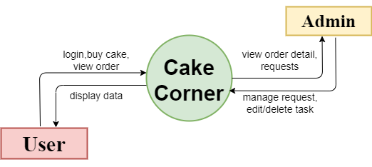
Cake Corner
DFD
Context Level DFD

Slide 15
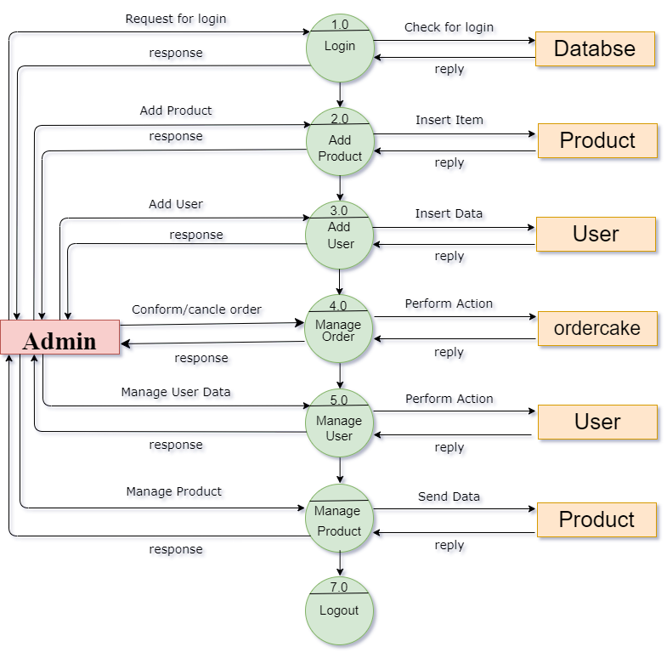
Cake Corner
Admin Level DFD
DFD

Slide 16
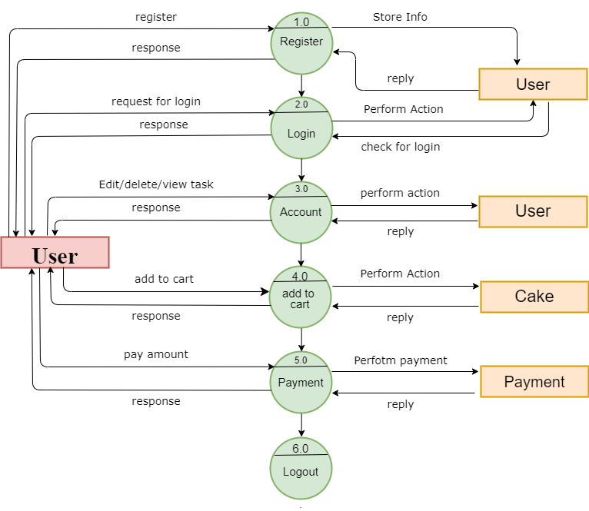
Cake Corner
User Side DFD
DFD

Slide 17
Advantage Of Cake Corner
General:-
Reduced Overhead Costs
Marketing Opportunities
Customer Reviews and Feedback
Admin:-
Real-Time Analytics
User Management
User/Customer:-
Easy Ordering Process
Delivery Option
Quality Assurance
Customer Support

Slide 18
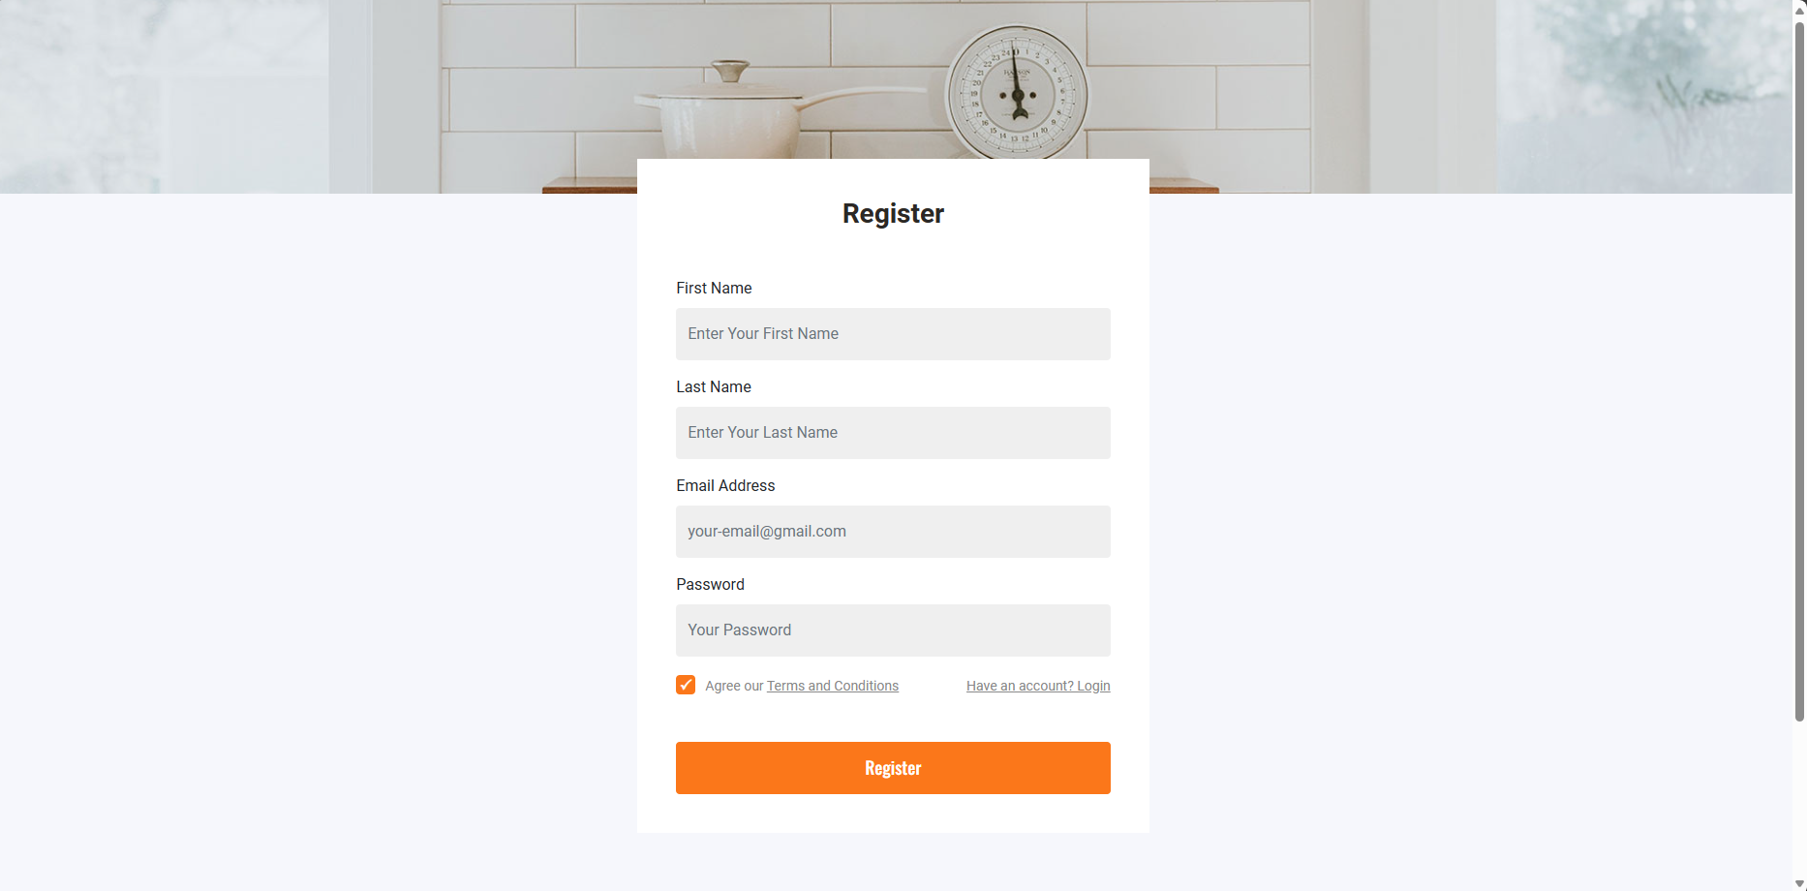
Screen Layouts – User Side
Registration Page

Slide 19
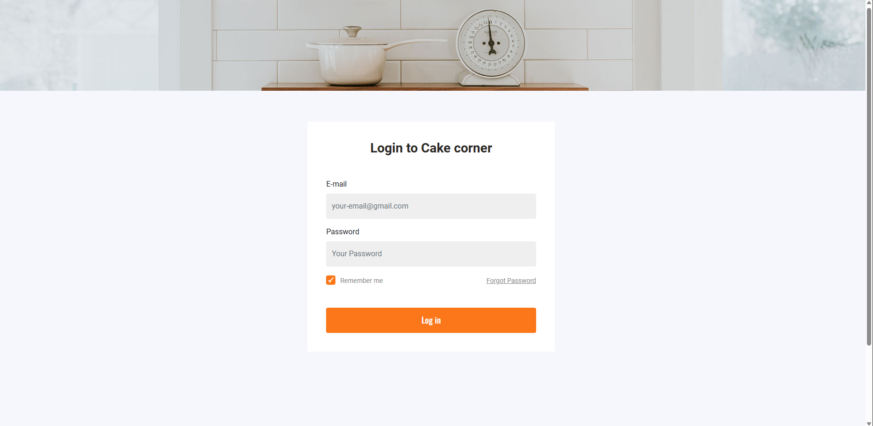
Screen Layouts
Login Page

Slide 20
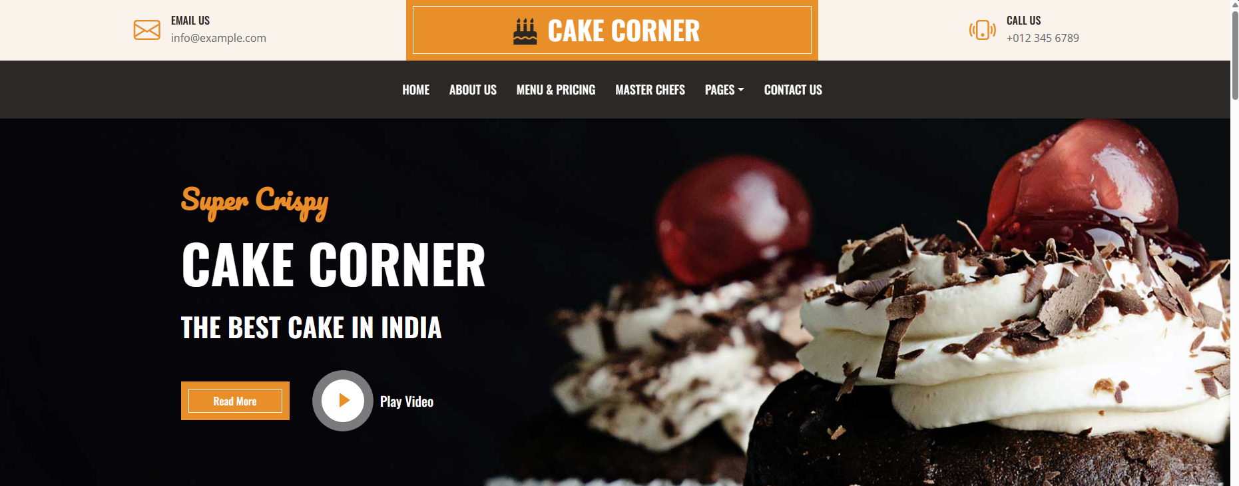
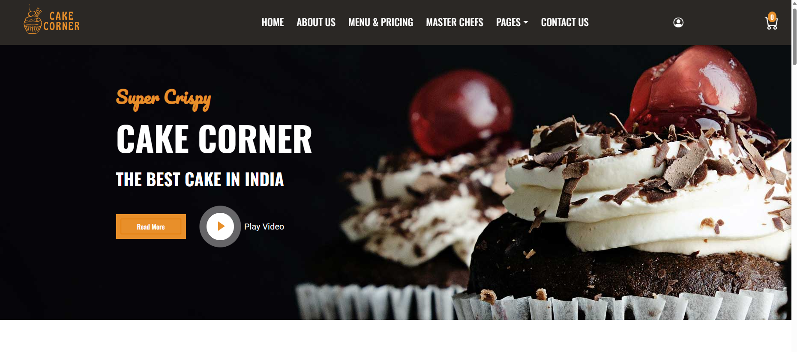
Screen Layouts
Home Page

Slide 21
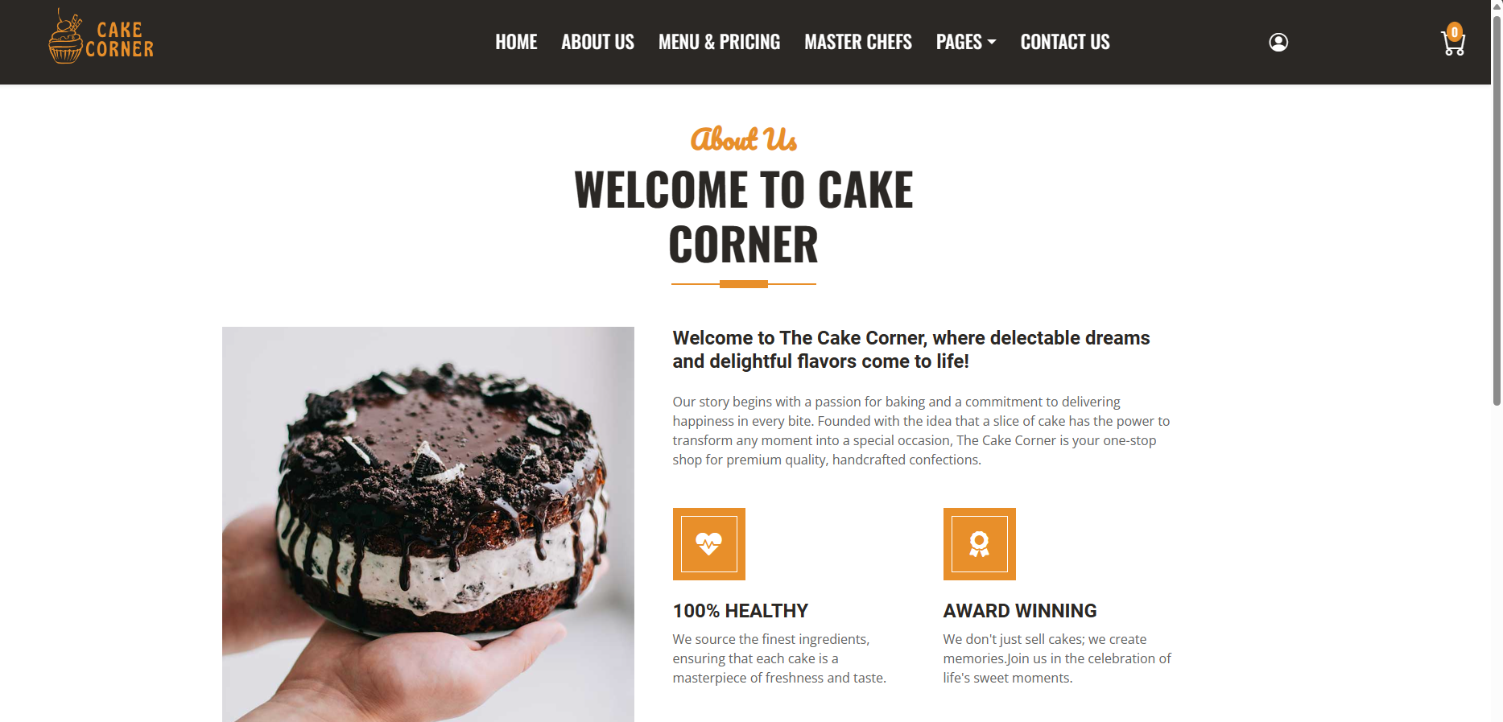
Screen Layouts
About Us Page

Slide 22
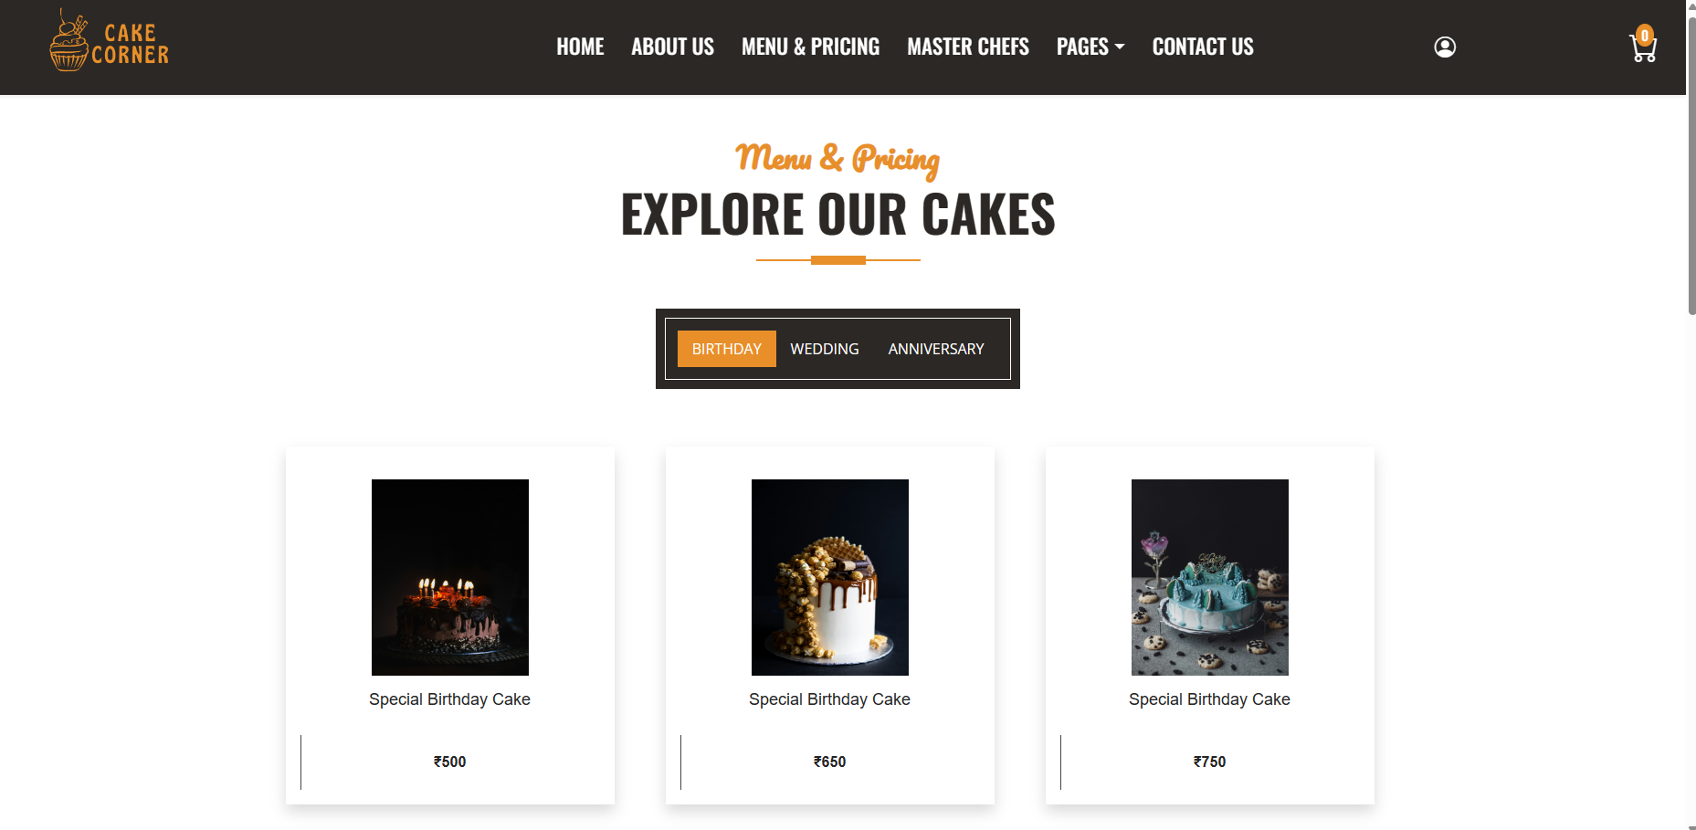
Screen Layouts
Menu & Pricing Page

Slide 23
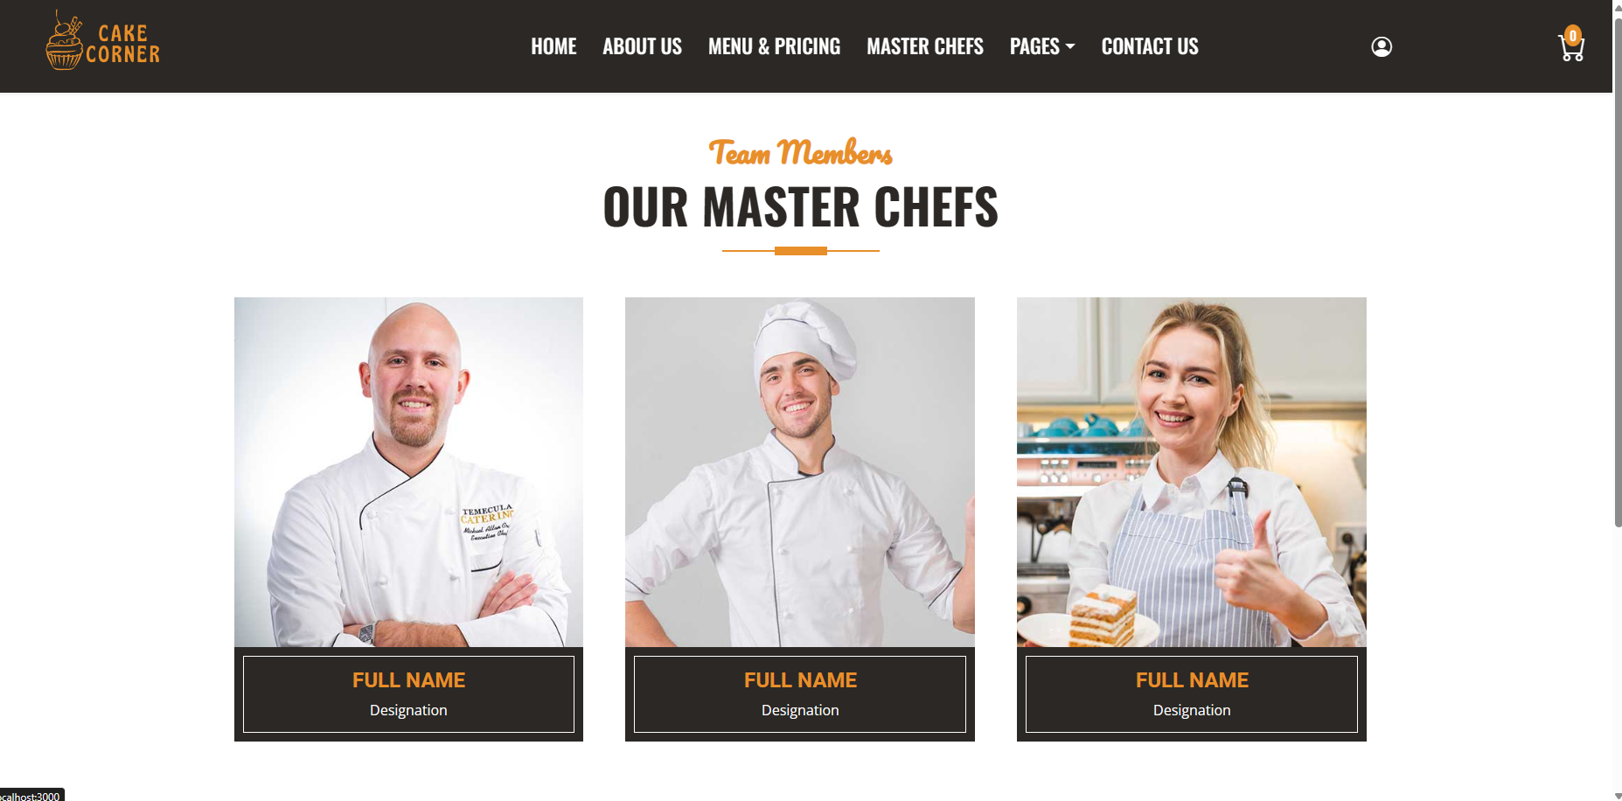
Screen Layouts
Team Member Page

Slide 24
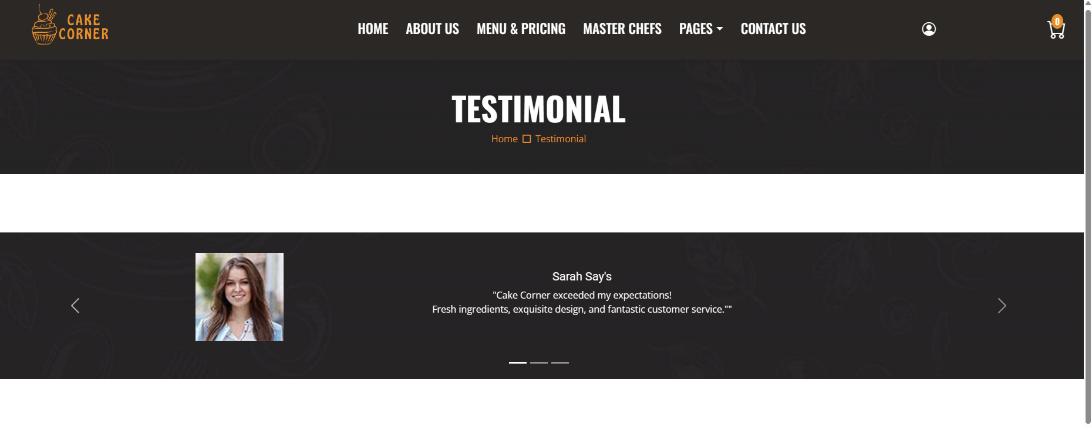
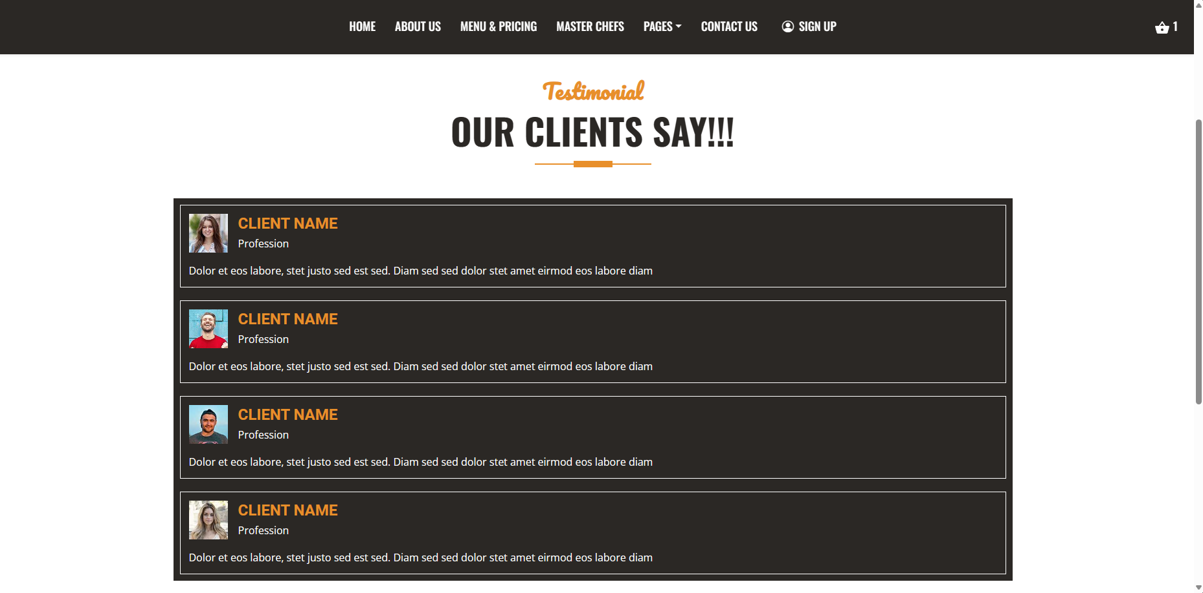
Screen Layouts
Testimonial Page

Slide 25
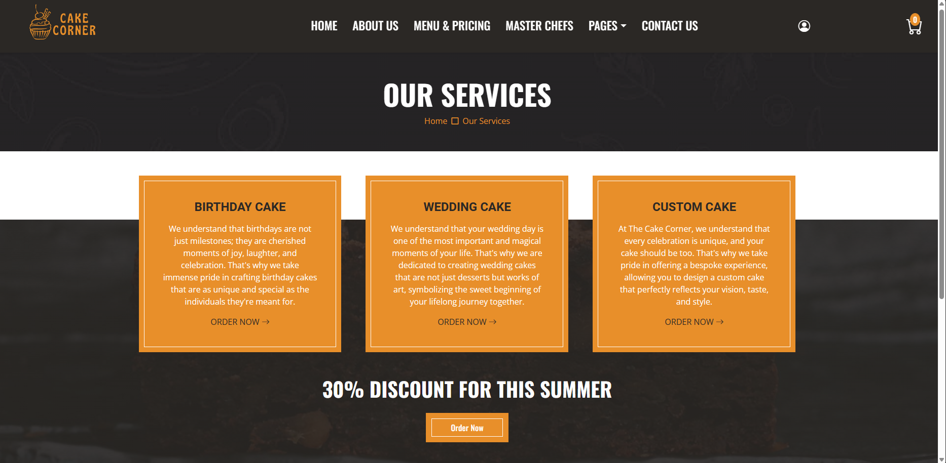
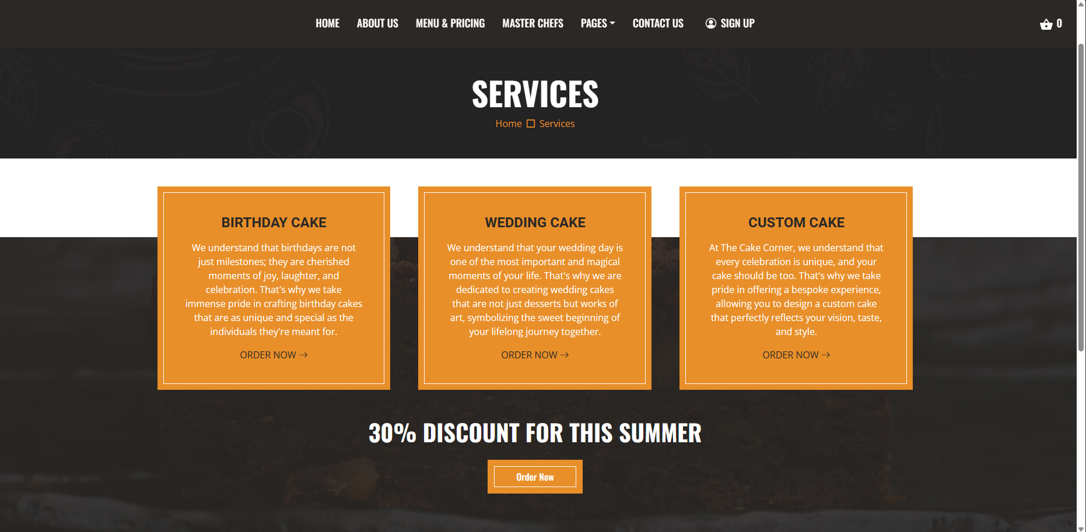
Screen Layouts
Our Service Page

Slide 26
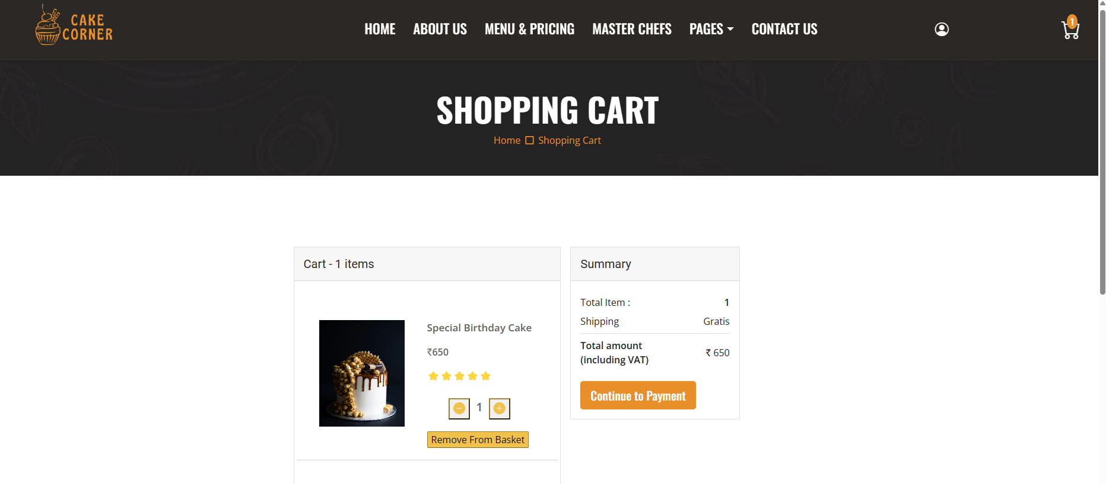
Screen Layouts
Shopping Cart Page

Slide 27
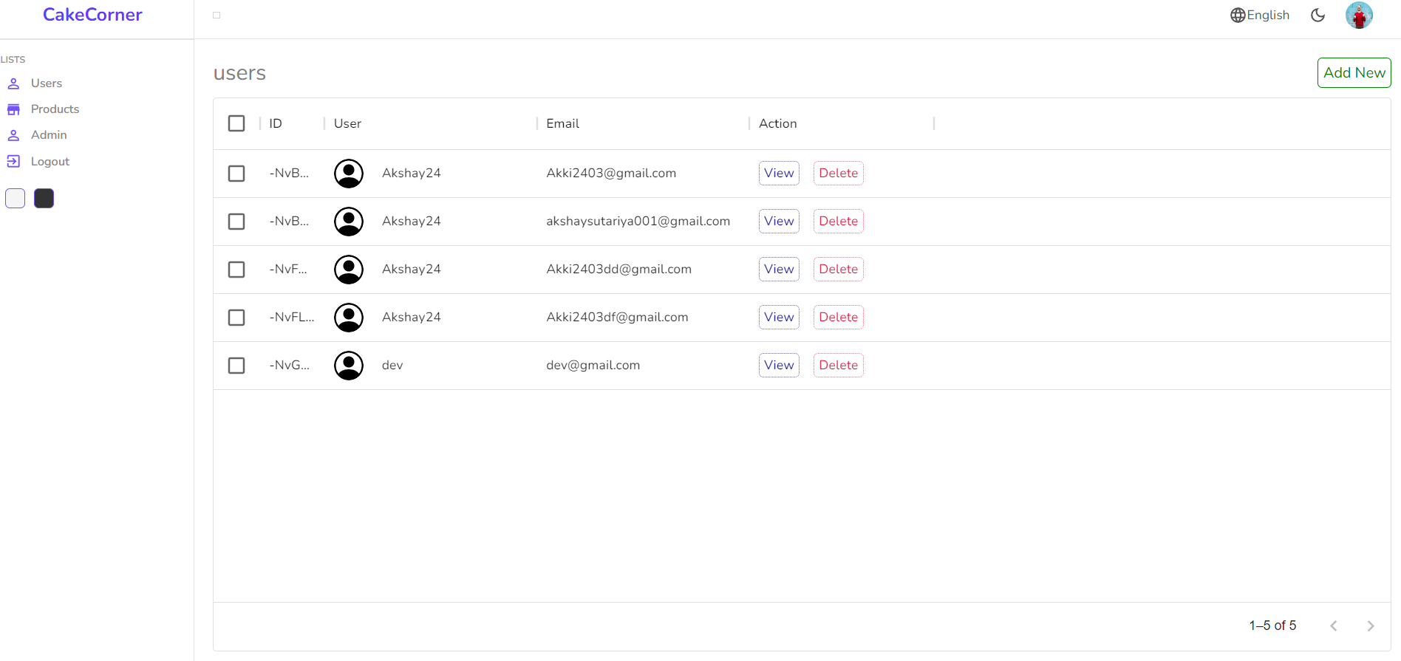
Screen Layouts – Admin Side
User Data Page

Slide 28
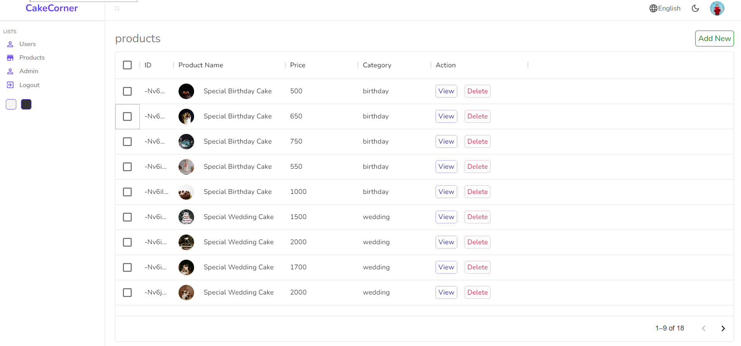
Screen Layouts
Product Page

Slide 29
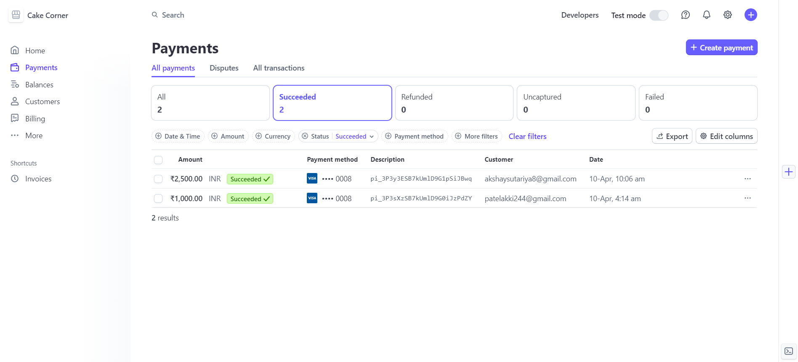
Screen Layouts
Payment Detail Page

Slide 30
Due to the time limitation, I have implemented only the main functionalities for the development of the Website. These functionalities are not sufficient to develop the project as I have very big plan for my website Cake Corner. Consequently, I will • Improve application performance. • Finish the remaining functionality. • Working on the project was good experience. I understand the importance of Planning and Designing as a part of software development. But it’s very difficult to complete the program for single person. • System provide major advantages such as speed and accuracy of operation, Time Efficiency, Cost Efficiency, Automatic data validation, Data security and reliability, Easy performance check, Dynamic and User Friendly. And ensures access to complete and critical information, instantly.
Conclusion

Slide 31
Thank You

